Slide 1

The Common Man Bank Ltd (CMB)
Credit Card Consumption Pattern

Slide 2
Problem Statement
Business Problem: CMB Bank can understand from the spending patterns and profile people based on their spending and tailor the loans or financial products based on those.
Business Impact: The consumption patterns and spends of a customer allow banks to build strategic partnerships with vendors for discounts or other plans to reward and retain customers, in turn impacting the revenue.
Data Science Problem statement: To predict the average spend of customers in the coming 3 months, to decide how to build strategy to partner a vendor and plan rewards to retain customers.
Data Science Metric: Root of Mean Squared Logarithmic Error (RMSLE).

Slide 3
Insight & Actions on Dataset
The train data set is of shape (15000, 39). Columns cc_cons_apr, cc_cons_may , cc_cons_jun and emi_active are missing from train dataset.
All features are numerical except account_type, gender and loan_enq which are categorical.
We will be dropping 9 columns , which are investment_4, loan_enq, vehicle_loan_active , investment_3, investment_1, vehicle_loan_closed nvestment_2, personal_loan_closed, personal_loan_active as they have nearly 91 % and more data missing.
Column ‘age’ has 8 values that are not sanitized. These needs to be curated.

Slide 4
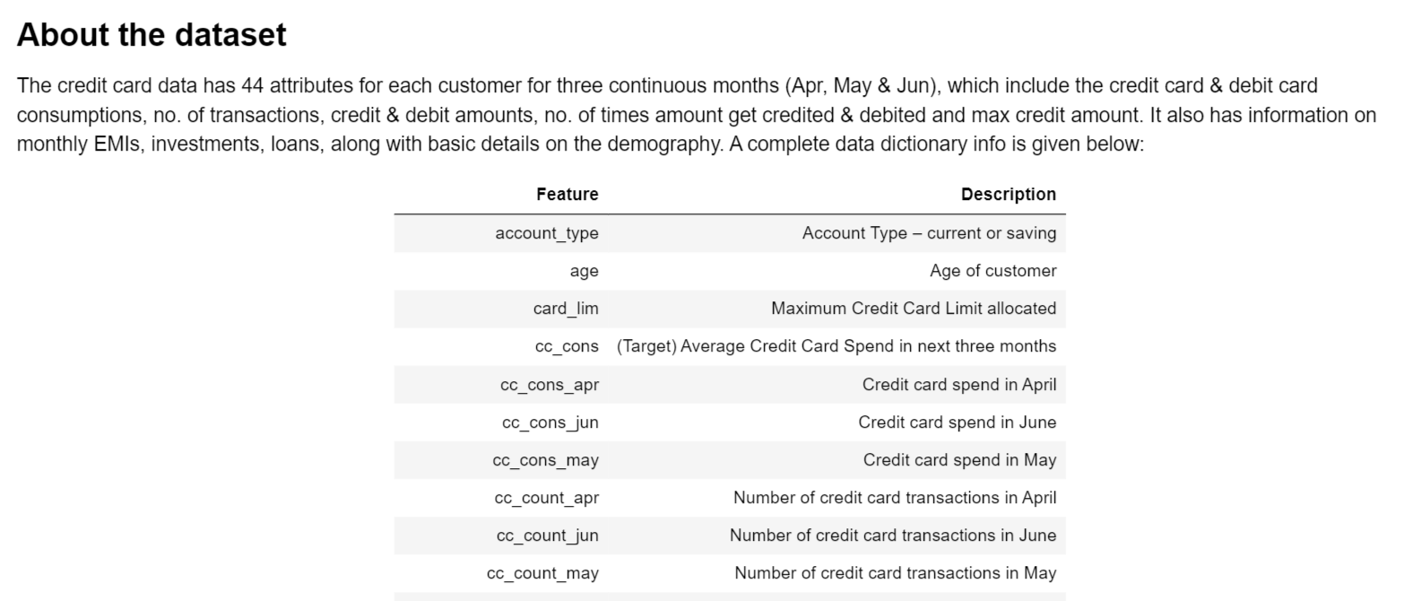
Let see our dataset :

Slide 5
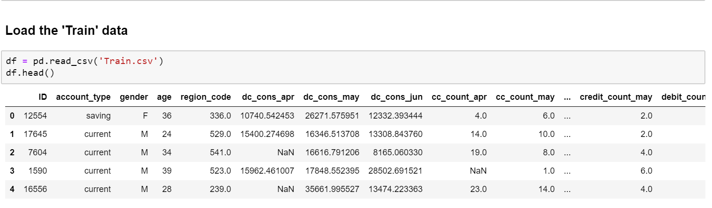

Slide 6
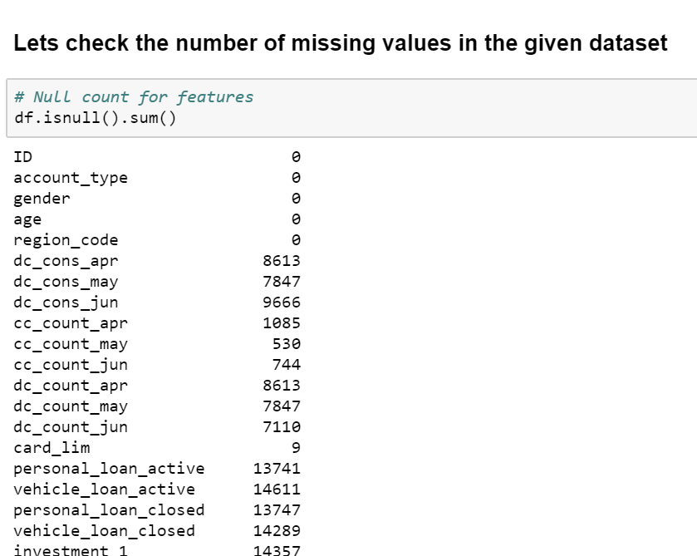
Null count for features

Slide 7
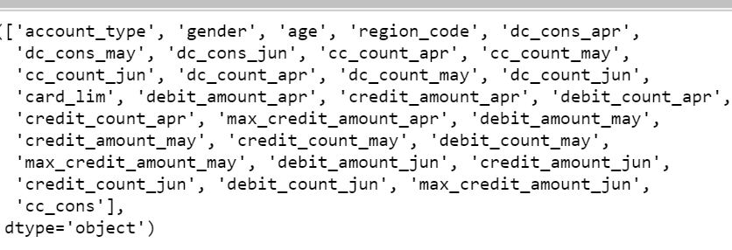
We see almost 90% of the features have null values.
So dropping features ('personal loan active', 'vehicle loan active', 'personal loan closed', 'vehicle loan closed', 'investment_1', 'investment_2', 'investment_3', 'investment_4' & 'loan enquiry') having more than 90% null data, to reduce the curse of dimensionality. Also dropping useless 'ID' column.

Slide 8
Now dealing with missing values

Slide 9
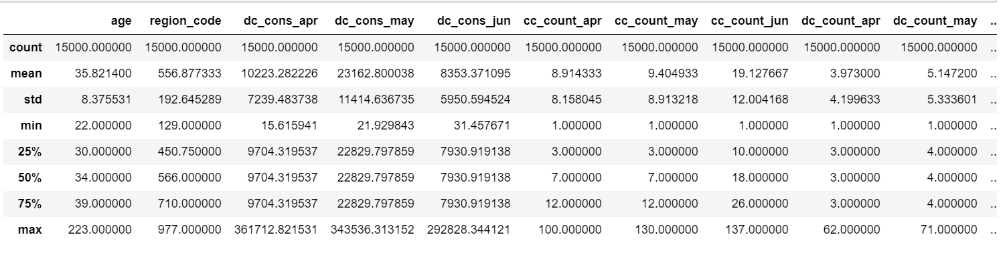
Lets also check the descriptive Statistics of the data

Slide 10
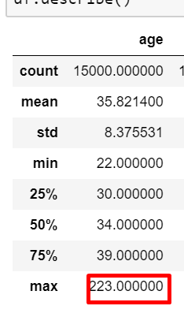
Max age looks to be incorrect, so dropping junk data from 'age'.

Slide 11
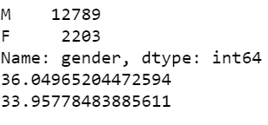
Insight
- How many men and women are represented in this dataset?
- What is the average age (age feature) of women?

Slide 12
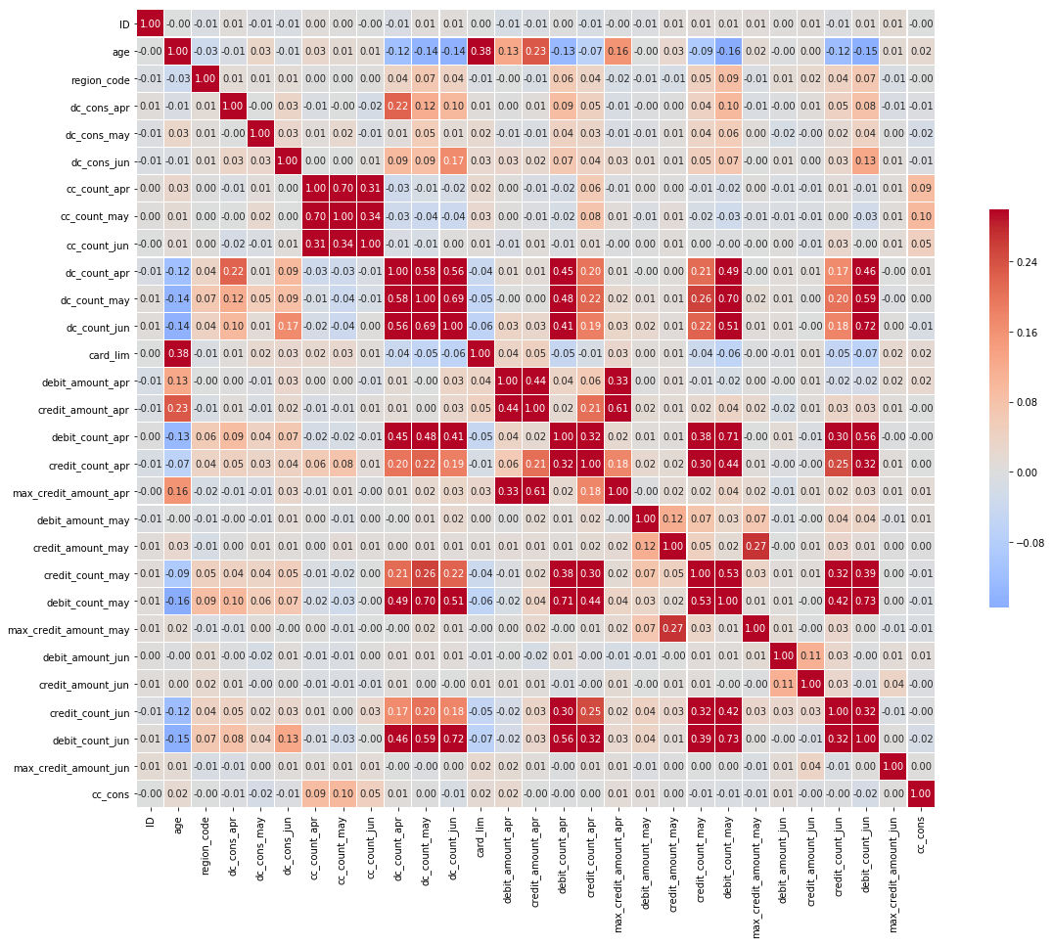
Correlations

Slide 13
There are three set of co-rrelated features:
1) dc_count_jun, dc_count_may & dc_count_apr 2) debit_count_apr, debit_count_may & debit_count_jun .3) cc_count_may & cc_count_apr
Also some relation we cannot avoid are:
1)age vs card_lim 2) max_credit_amount_apr vs credit_amount_apr 3) debit count vs credit count

Slide 14
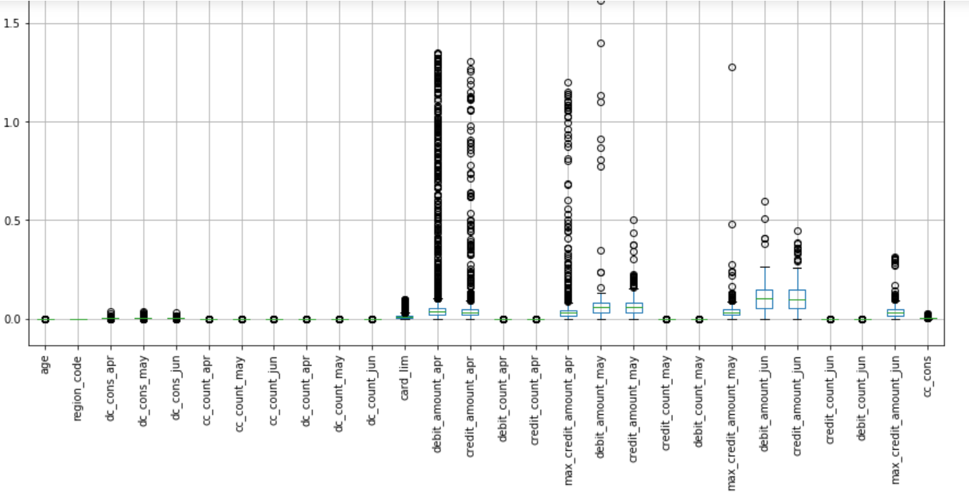
Uni-variate Analysis
It seems like data have many outliers. The features like dc_cons_apr, dc_cons_may, dc_cons_jun, card_lim, debit_amount_apr, credit_amount_apr, max_credit_amount_apr, debit_amount_may, credit_amount_may, max_credit_amount_may, debit_amount_jun, credit_amount_jun and max_credit_amount_jun have outliers.
Need to treat using log/ squart transformation before standardizing. This is done when the variables span several orders of magnitude.
Mostly because of skewed distribution. Logarithm naturally reduces the dynamic range of a variable so the differences are preserved while the scale is not that dramatically skewed.

Slide 15
It seems like data have many outliers:
the features like dc_cons_apr, dc_cons_may, dc_cons_jun, card_lim, debit_amount_apr, credit_amount_apr, max_credit_amount_apr, debit_amount_may, credit_amount_may, max_credit_amount_may, debit_amount_jun, credit_amount_jun and max_credit_amount_jun have outliers.
Need to treat using log/ squart transformation before standardizing. This is done when the variables span several orders of magnitude.
Mostly because of skewed distribution. Logarithm naturally reduces the dynamic range of a variable so the differences are preserved while the scale is not that dramatically skewed.
Many features have outliers. Hence we are droping the quantile greater than 0.99.

Slide 16
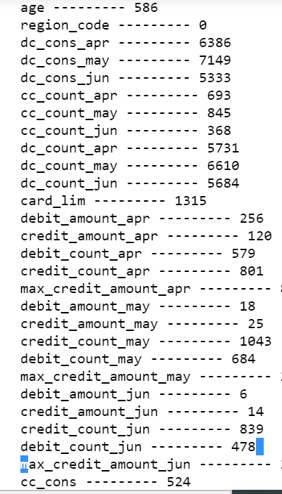

Slide 17
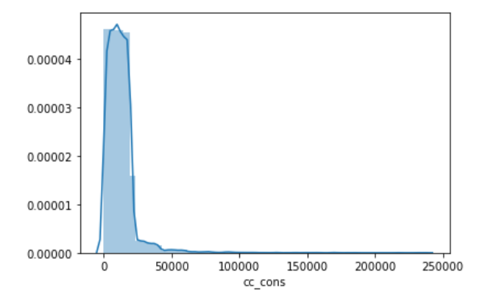
Plot the distribution of target variable
Target variable is right skewed

Slide 18
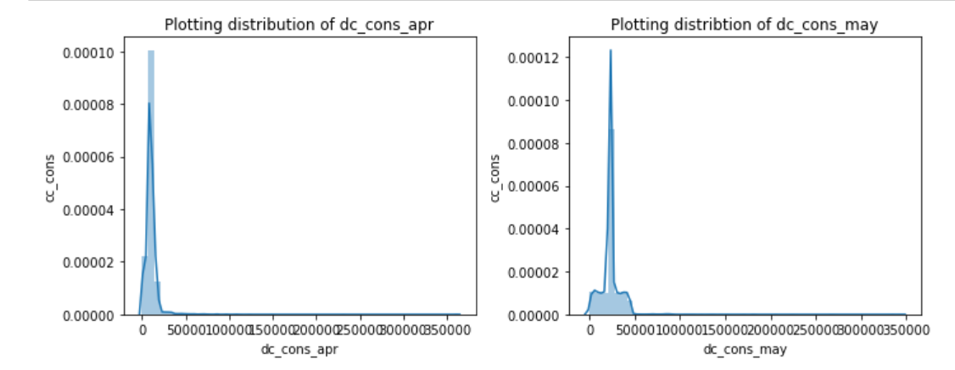
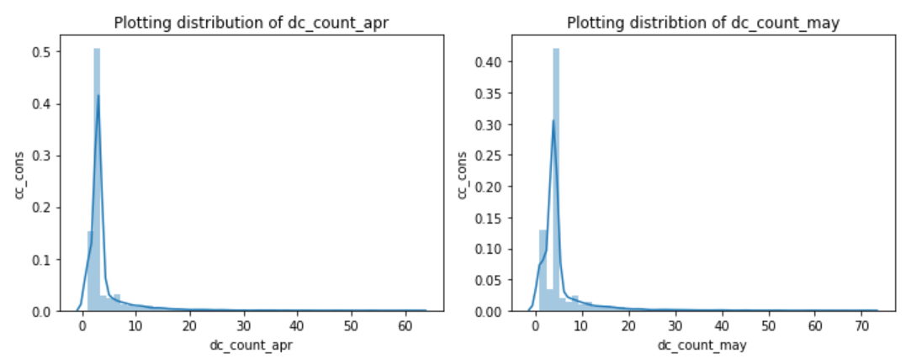
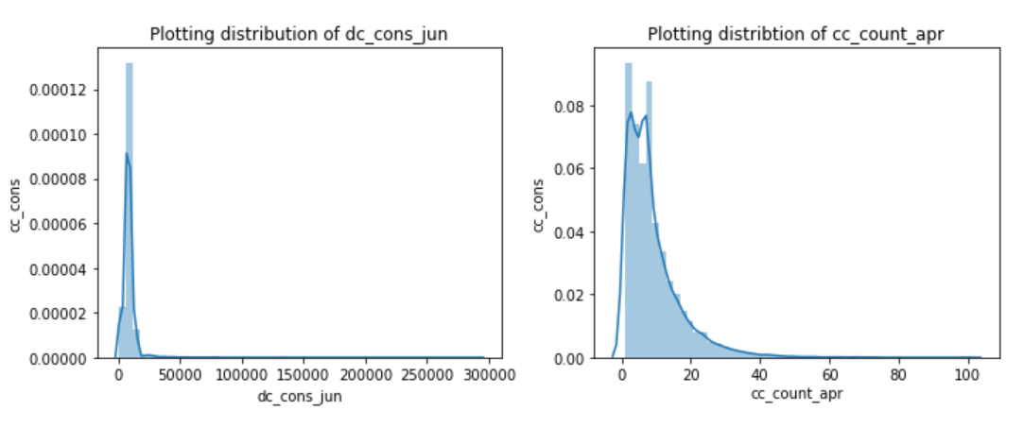
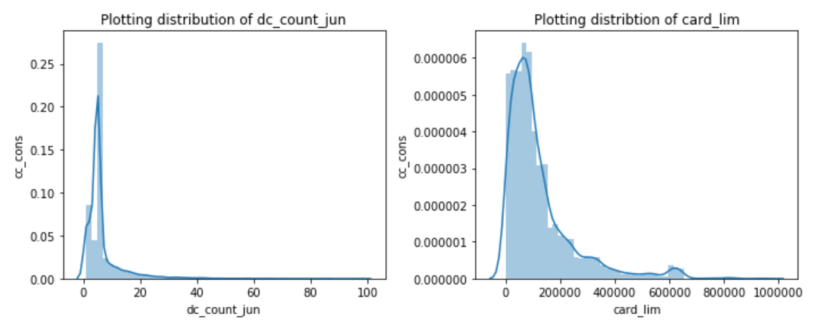
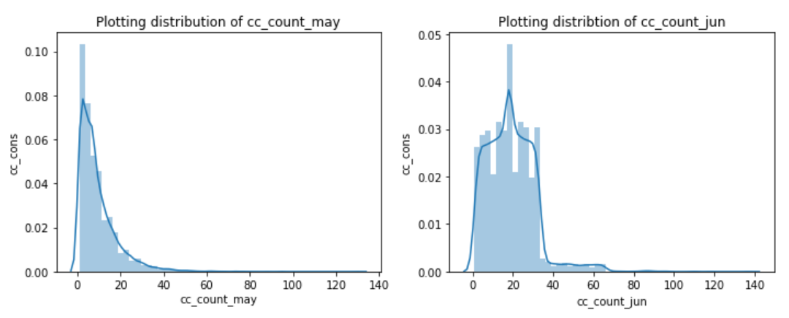
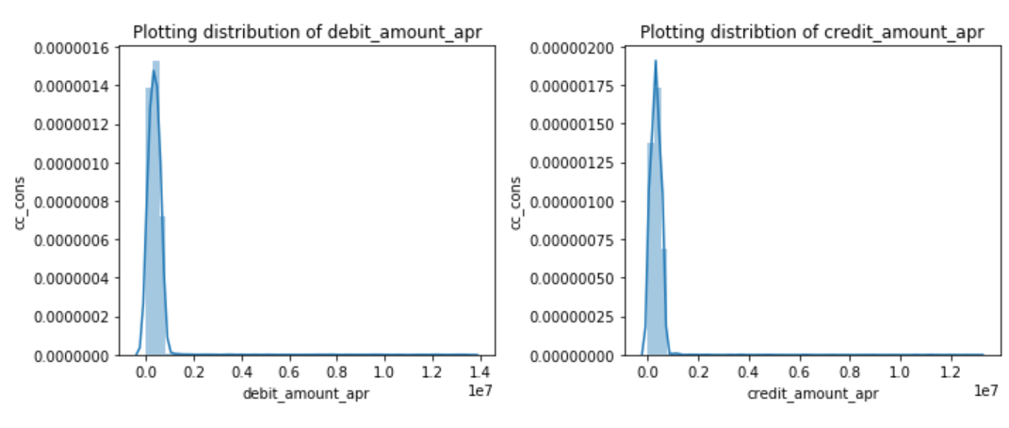
Check the skewness of numerical columns by plotting histograms.

Slide 19
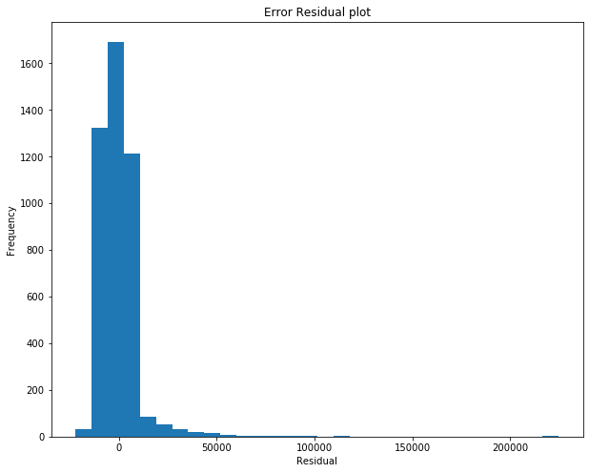
Using baseline regression model
Residuals

Slide 20
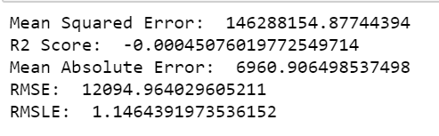
Evaluate the above model using error metrics.
Linear Regression error metrics are `RMSE` , `RMSLE`, `R2_SCORE` , `MAE`, `MSE`.
Linear Regression is not fitting for the given dataset

Slide 21
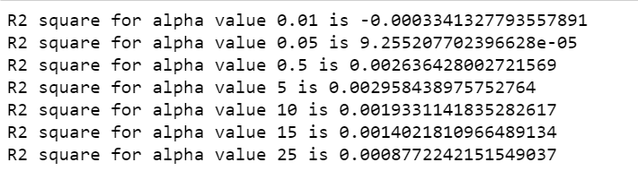
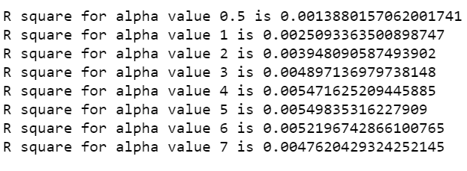
Lasso and Ridge might be of some help for non-linearity in the model.
Ridge Regression
Lasso regression

Slide 22


Insight
- How many men and women are represented in this dataset?
- What is the average age (age feature) of women?
Does people spend more with debit card vs credit card?
No of transaction comparision in debit & credit card

